Slide 1
Sensation, Perception, and Attention

Slide 2
Perceiving the world
Sensory systems = sense organs having 5 major senses
What are your senses?
Hearing
Vision
Taste
Touch
Smell
How do we make meaningful interpretation from what our senses take in?
Environment stimulus.. Attention.. picked.. taken in by the sensory receptors.. neural stimulation.. brain receive/read.. sensation completed.. Brain meaningfully interprets it.. Perception.. Cognition..

Slide 3
Senses
Smell /olfactory
Seeing/ visual/optical
Hearing/auditory
Taste/gustatory
Touch/tactile
Distinguishing ability.

Slide 4
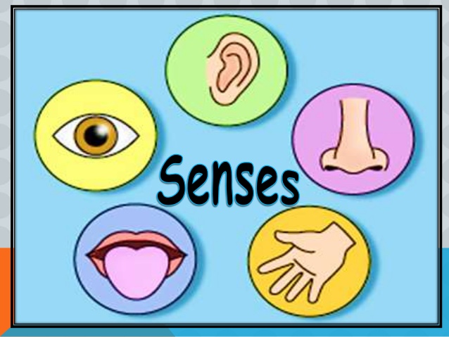
SENSATION
( Your window to the world )
The passive process of bringing information from the outside world into the body and to the brain.
Sensation occurs when special receptors in the sense organs- the eyes, ears, nose, skin and taste buds are activated allowing various forms of outside stimuli to become neural signal in the brain.

Slide 5


Sensation happens when you feel wind on your face.
Feeling pulse

Slide 6
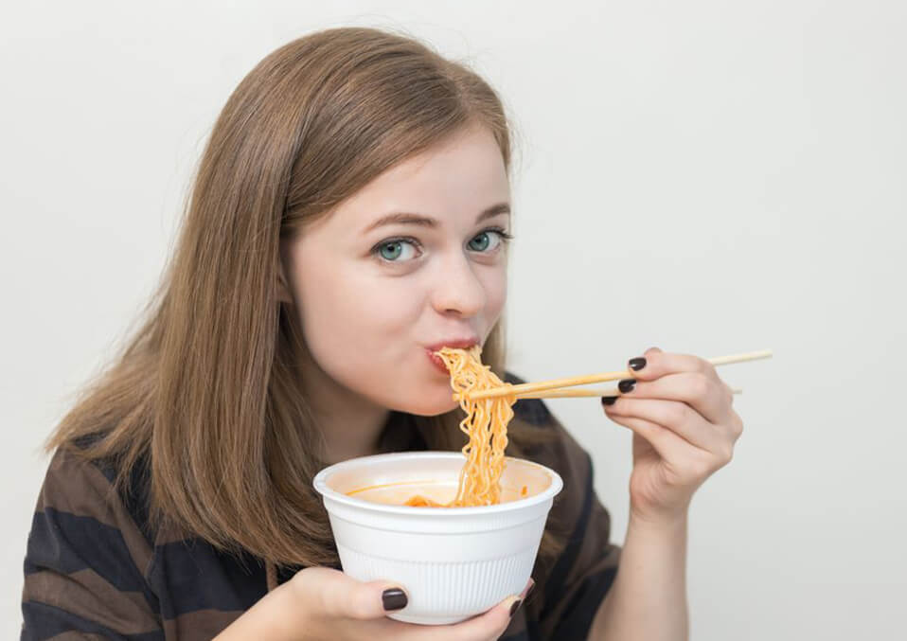
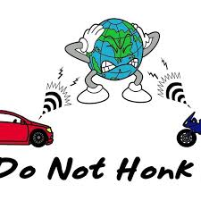
Sensation happens when you eat noodles.
Or
When you hear a car horn honking in the distance.

Slide 7
The Computational Brain
humans use the computational brain to perceive information about the environment, attend to the world, and process information during the initial stages
We see, hear, smell, taste, and feel
sensations of the world as the first link in a chain of events that subsequently involves coding stimuli; storing information; transforming material; thinking; and, finally, reacting to knowledge
concept of the computational brain is based on —it processes information.

Slide 8
Sensation and Perception
Sensation refers to the initial detection of energy from the physical world
Perception, on the other hand, The sorting out, interpretation, analysis, and integration of stimuli by the sense organs and brain.
Stimulus is any passing source of physical energy that produces a response in a sense organ.

Slide 9
Vision: act of sensing a small section of electromagnetic waves referred to as light
Light rays enter the eye through the cornea and lens, which focus an image on the retina
illusion of three-dimensionality is made possible
human eye has about 7 million cones, and about 125 million rods
Cones are concentrated in the fovea, and are responsible for color and fine vision

Slide 10
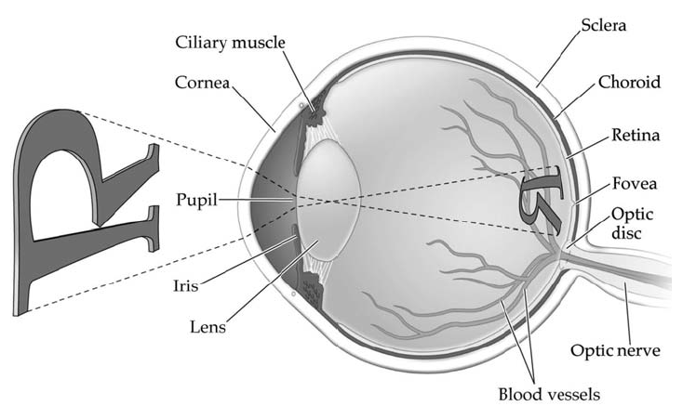

Slide 11
Sensory Coding
One of the several information processing occurrences in the nervous system.
This process involves four different but highly related events, which include
Reception
Transduction
Coding
Awareness

Slide 12
Our senses “boil down” floods of information into streams of useful data
After our senses analyze information, our senses use sensory “coding”
Sensory coding: converting sensory information to neural messages that are understood by brain {transduction}

Slide 13
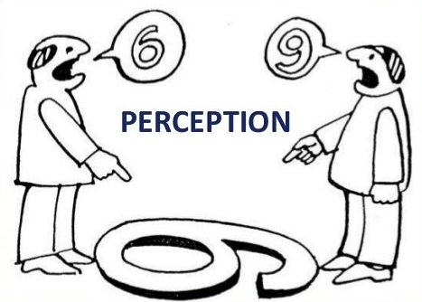
PERCEPTION
Perception is the active process of selecting, organizing and interpreting the information brought to the brain by the senses.
The perceptual process is a sequence of steps that begins with the environment and leads to our perception of stimulus and action in response to the stimulus.

Slide 14
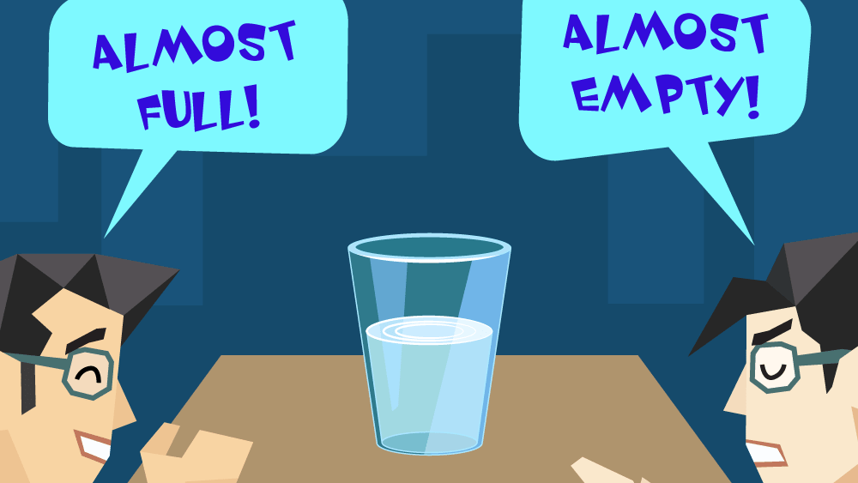

Slide 15
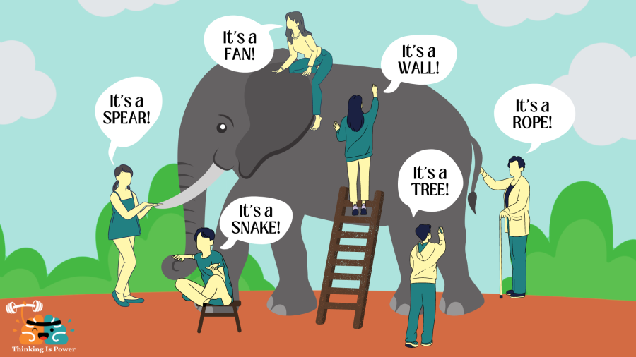

Slide 16
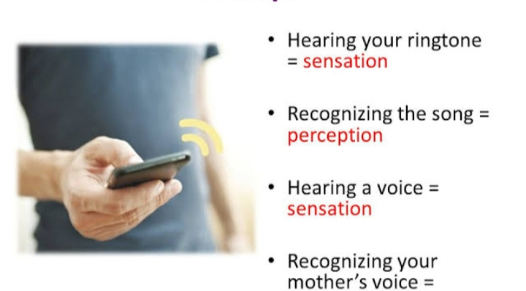

Slide 17
Absolute threshold
Absolute threshold is the smallest level of stimulus that can be detected.
In hearing, the absolute threshold refers to the smallest level of a tone that can be detected by normal hearing when there are no other interfering sounds present.
In vision, the absolute threshold refers to the smallest level of the light that a person can detect.
In smell, for odors, the absolute threshold involves the smallest amount that a person is able to smell.
In the absolute threshold of touch, the amount of force required for you to detect the feeling of feather lightly brushing your arm.

Slide 18
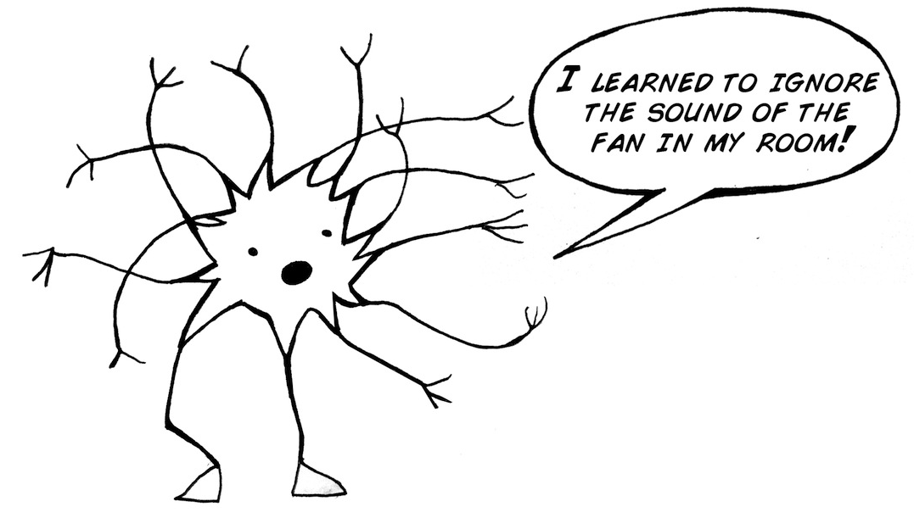
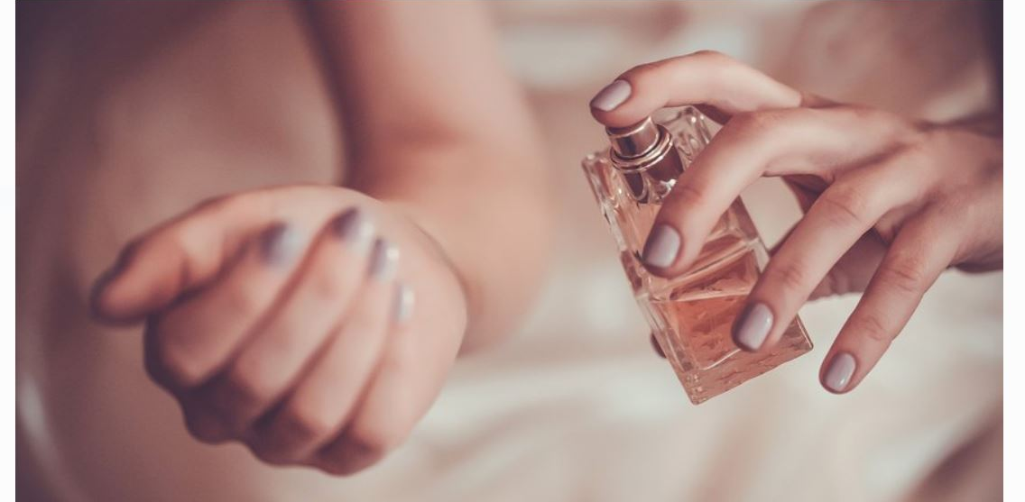
SENSORY ADAPTATION
The process in which changes in the sensitivity of sensory receptors occur in relation to the stimulus.
Gradual decrease over time in the responsiveness of the sensory system to a constant stimulus.

Slide 19
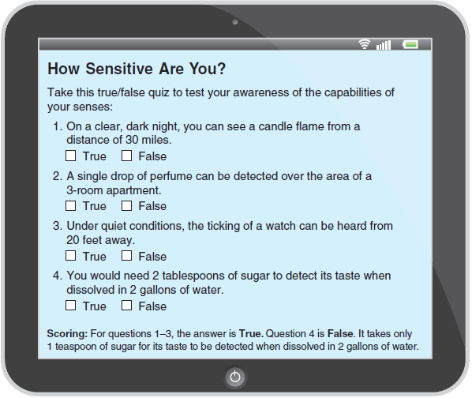

Slide 20
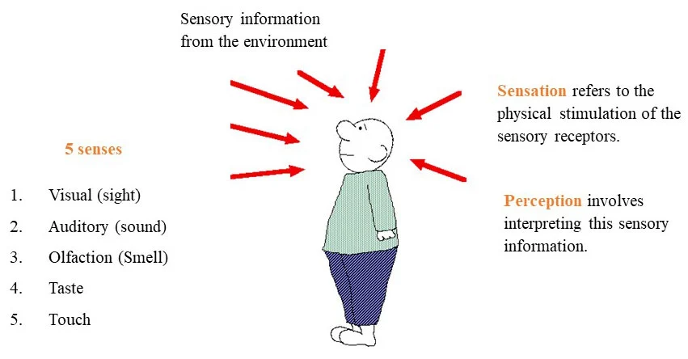
Let’s revise

Slide 21
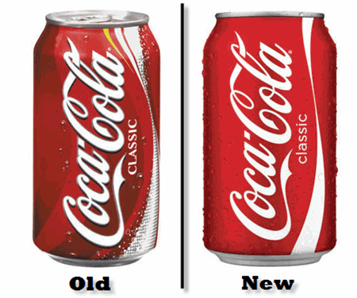
Difference Thresholds: Noticing Distinctions Between Stimuli
Difference threshold is the smallest level of added (or reduced) stimulation required to sense that a change in stimulation has occurred.
The difference threshold is the minimum change in stimulation required to detect the difference between two stimuli, and so it also is called a just noticeable difference

Slide 22
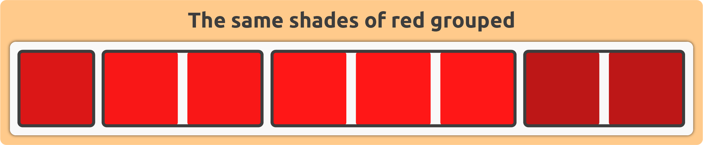

Slide 23
Cont.
Weber’s law helps explain why a person in a quiet room is more startled by the ringing of a telephone than is a person in an already noisy room.
To produce the same amount of reaction in a noisy room, a telephone ring might have to approximate the loudness of cathedral bells.
Similarly, when the moon is visible during the late afternoon, it appears relatively dim—yet against a dark night sky, it seems quite bright.

Slide 24
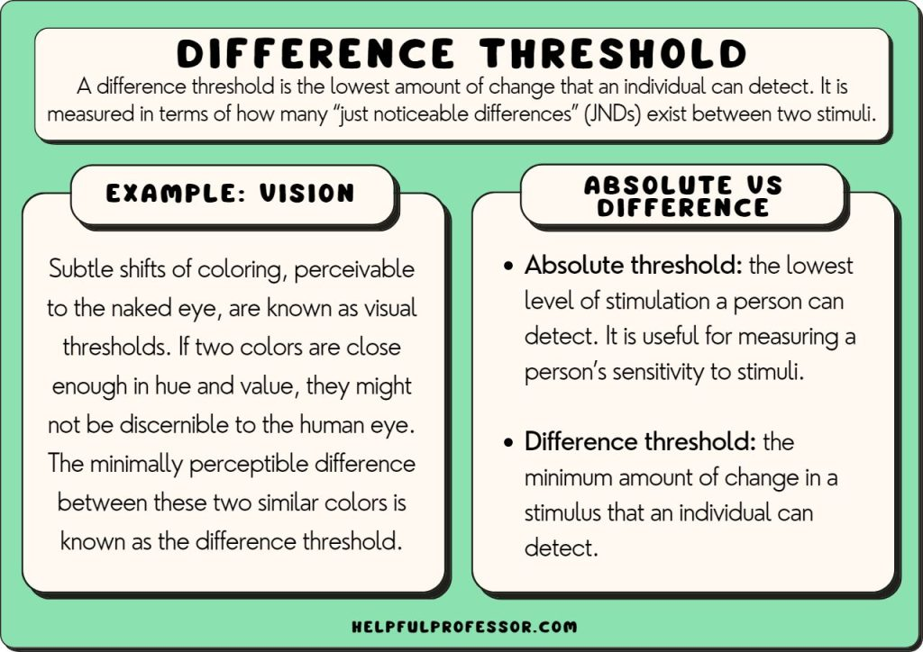

Slide 25
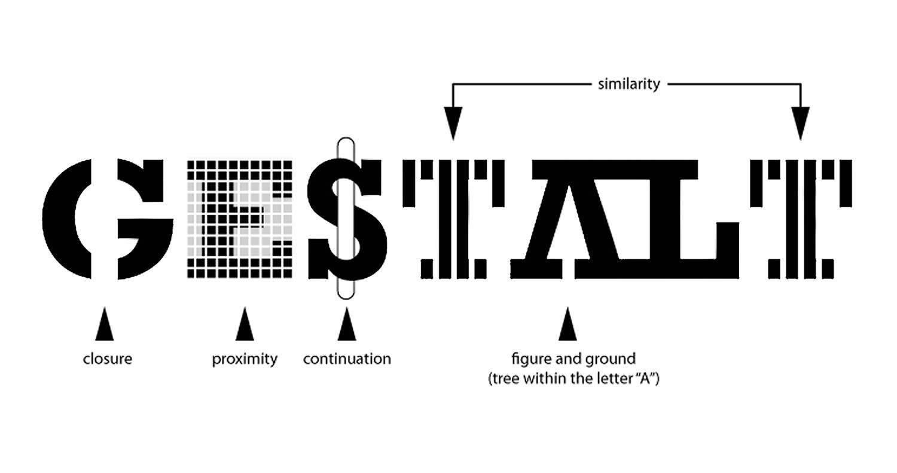
GESTALT THEORIES OF PERCEPTION

Slide 26
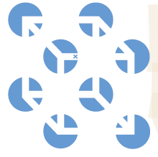
THE GESTALT LAWS OF ORGANIZATION
When given a cluster of sensations, people tend to organize them into a gestalt, a German word meaning a “form” or a “whole.”
For example, Note the individual elements of this figure, called a Necker cube
Gestalt psychologists demonstrated many principles we use to organize our sensations into perceptions
Our brain does more than register information about the world.

Slide 27


Cont…
Figure and ground
each figure is two-dimensional
the usual means we employ for distinguishing the figure from the ground do not work.
We do not just passively respond to visual stimuli that happen to fall on our retinas.
Rather, we actively try to organize and make sense of what we see.

Slide 28


Cont….
FORM PERCEPTION
GROUPING
Having discriminated figure from ground, we must also organize the figure into a meaningful form
Our minds bring order and form to stimuli by following certain rules for grouping.
Proximity We group nearby figures together.
Continuity We perceive smooth, continuous patterns rather than discontinuous ones.

Slide 29




Cont…..
Closure We fill in gaps to create a complete, whole object.
Similarity Elements that are similar in appearance we perceive as grouped together
Figure and ground: distinguishing figure from the base or the ground.
Simplicity : When we observe a pattern, we perceive it in the most basic, straightforward manner that we can.

Slide 30
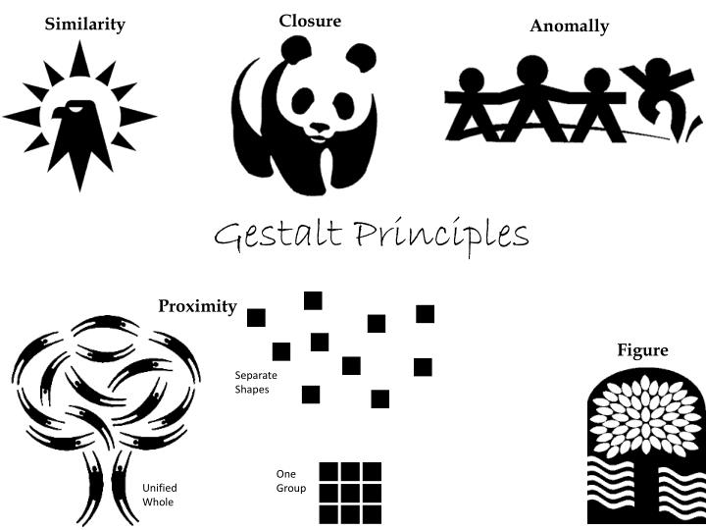

Slide 31
Top-down Processing
Ca- yo- re-d t-is -en-en-e, w-ic- ha- ev-ry -hi-d l-tt-r m-ss-ng?
In top-down processing , perception is guided by higher-level knowledge, experience,
expectations, and motivations. You were able to figure out the meaning of the sentence with the missing letters because of your prior reading experience and because written English contains redundancies.

Slide 32
Bottom-up Processing
Bottom-up processing consists of the progression of recognizing and processing information from individual components of a stimuli and moving to the perception of the whole.
We would make no headway in our recognition of the sentence without being able to perceive the individual shapes that make up the letters.

Slide 33
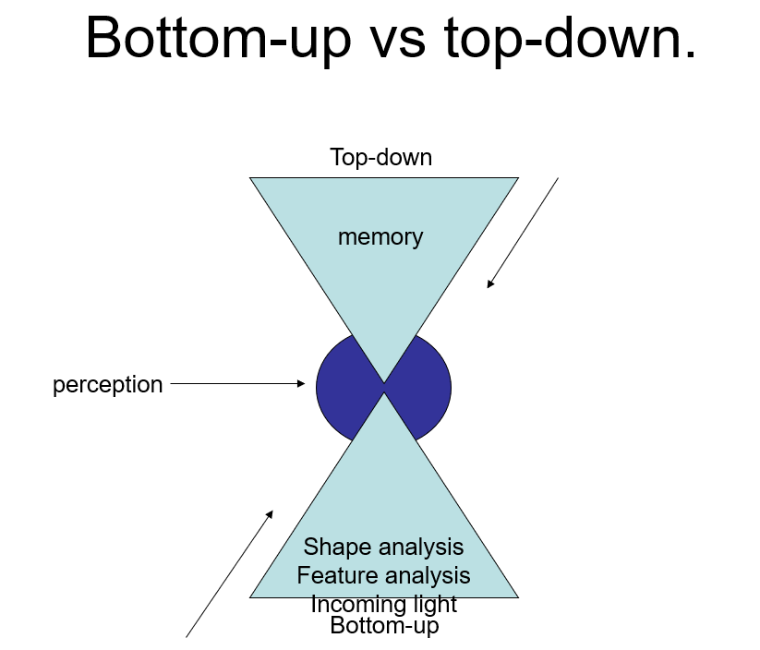

Slide 34

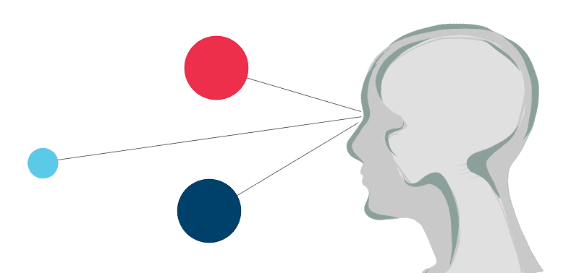
DEPTH PERCEPTION
The ability to view the world in three dimensions and to perceive distance—a skill known as depth perception —is due largely to the fact that we have two eyes.
Because there is a certain distance between the eyes, a slightly different image reaches each retina. The brain integrates the two images into one view, but it also recognizes the difference in images and uses this difference to estimate the distance of an object from us.

Slide 35
How do we make the transformation from 2-D to 3-D?
To get a sense of binocular disparity, hold a pencil at arm’s length and look at it first with one eye and then with the other. There is little difference between the two views relative to the background. Now bring the pencil just 6 inches away from your face and try the same thing. This time you will perceive a greater difference between the two views.
The fact that the discrepancy between the images in the two eyes varies according to the distance of objects that we view provides us with a means of determining distance.

Slide 36
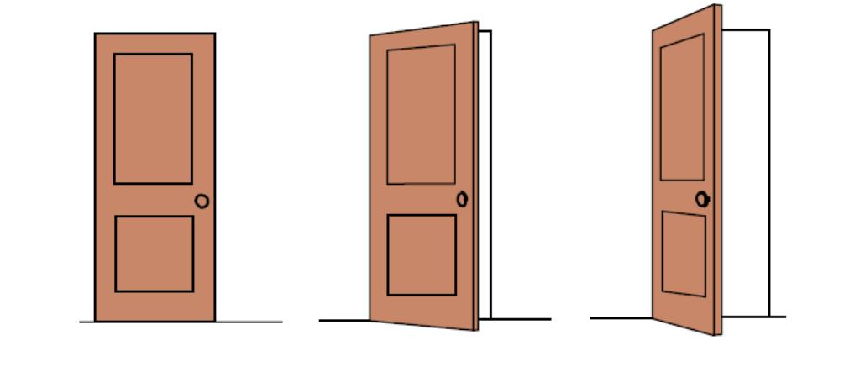
PERCEPTUAL CONSTANCIES
Perceptual constancy refers to perceive an object you are familiar with as having a constant shape, size and brightness despite the stimuli changes that occur.
The tendency of animals and humans to see familiar objects as having standard shape, size, colour, or location regardless of changes in the angle of perspective, distance, or lighting.

Slide 37
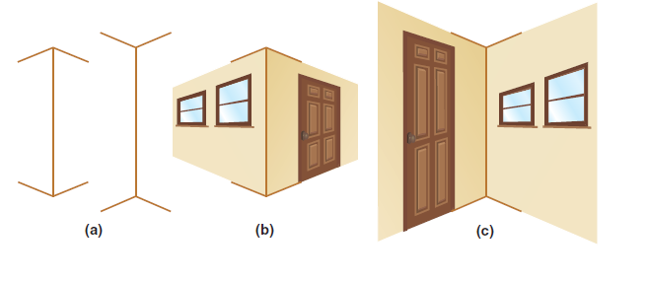
Illusions
The distinction between sensations and the perceived interpretation of those experiences
Sometimes reality and perception do not match, as in the case of perceptual illusions
The explanation of this illusion is probably partly influenced by our past experiences
to expect that certain shapes are far away and others close
For example Muller-Lyer illusion

Slide 38

OPTICAL ILLUSION
An optical illusion is characterized by visually perceived images that at least in common sense term are deceptive or misleading.
While optical illusions can be fun and interesting, they can also reveal a great deal about the working of the brain.

Slide 39
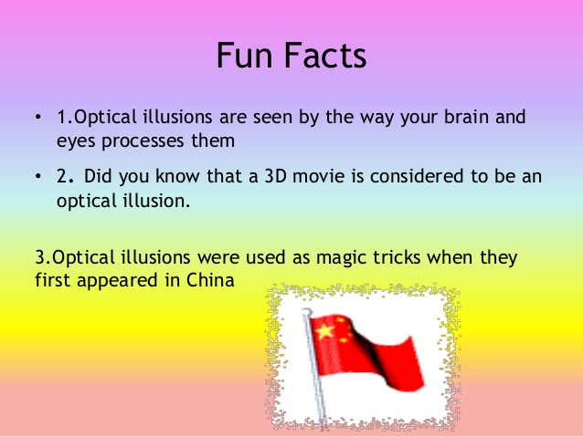

Slide 40
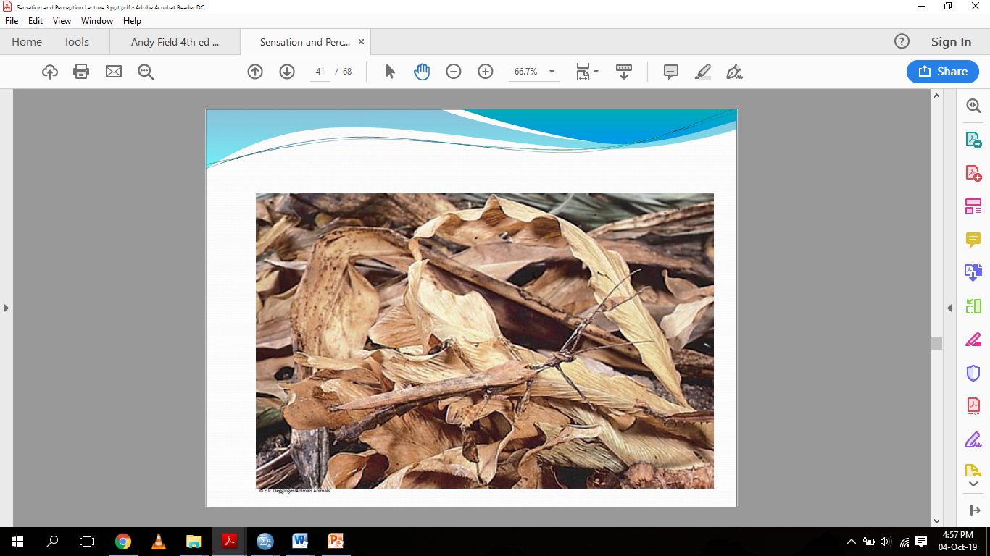

Slide 41
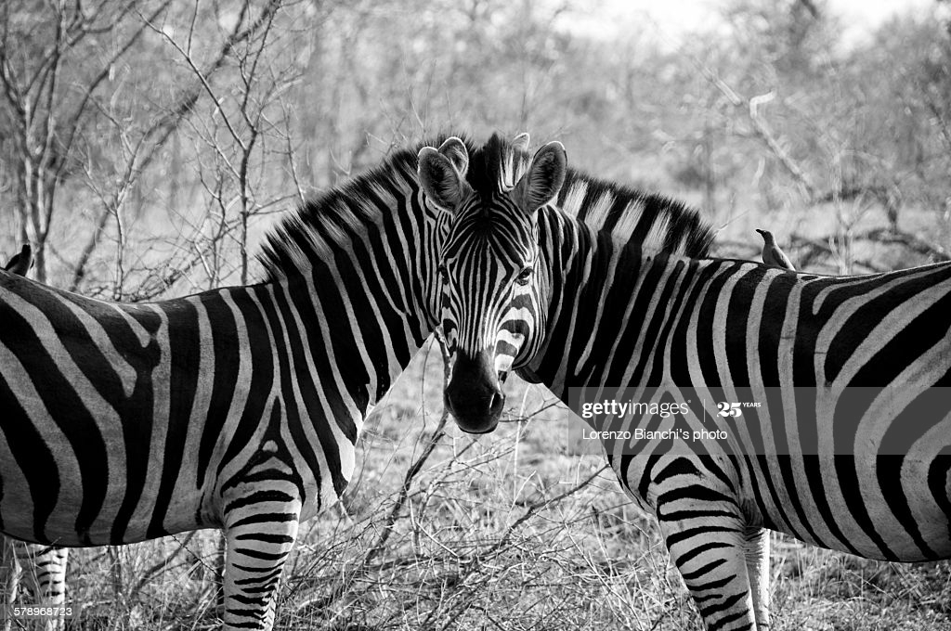

Slide 42
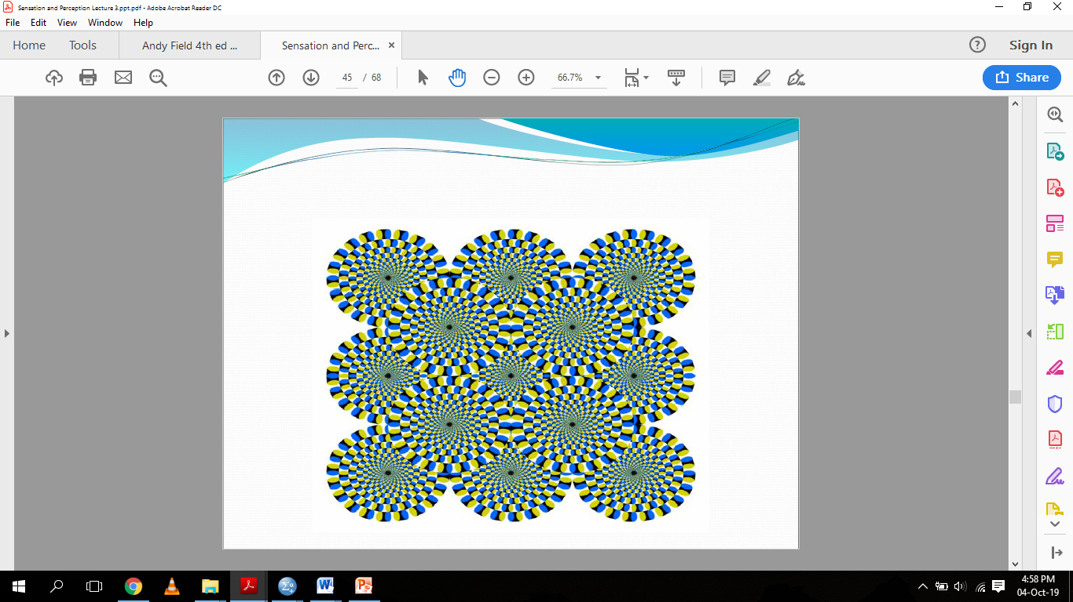

Slide 43
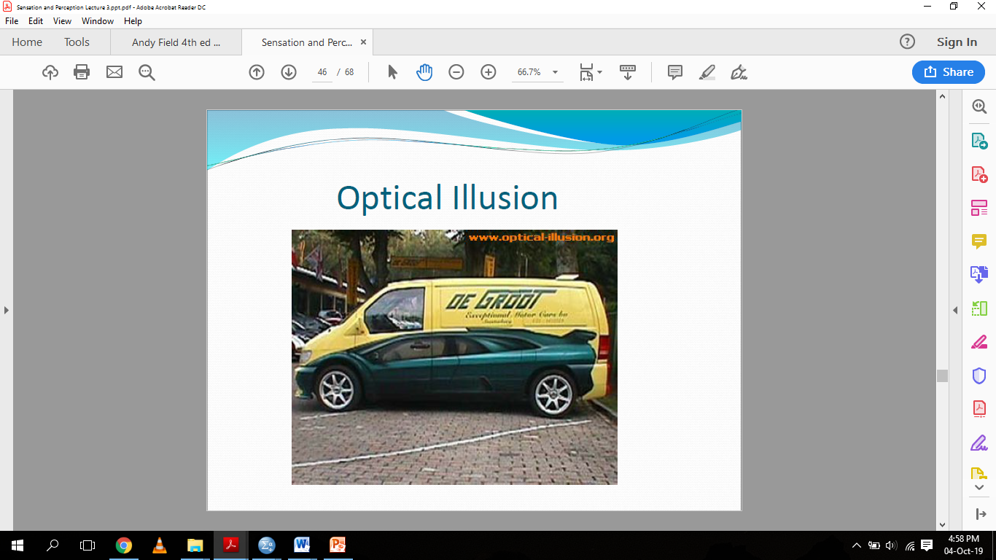

Slide 44
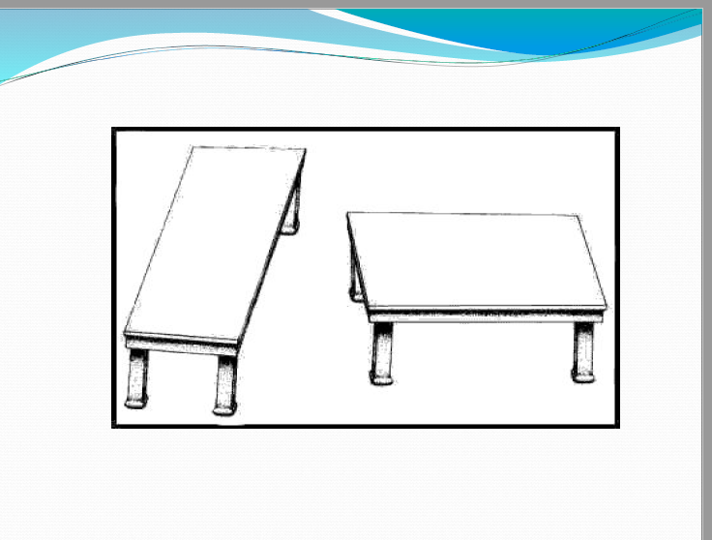

Slide 45
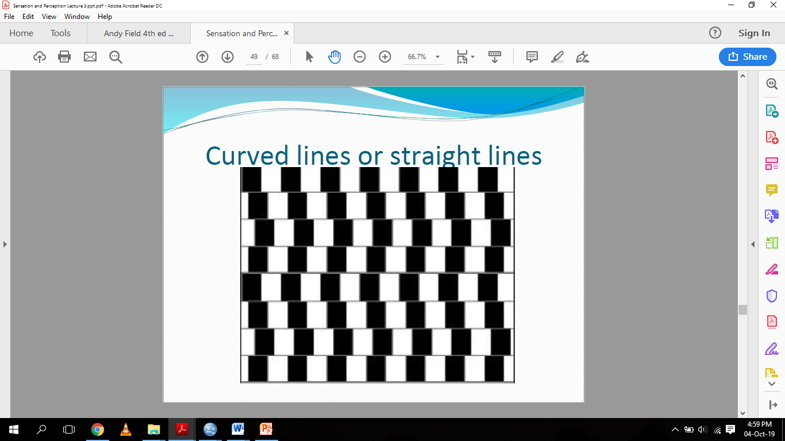

Slide 46
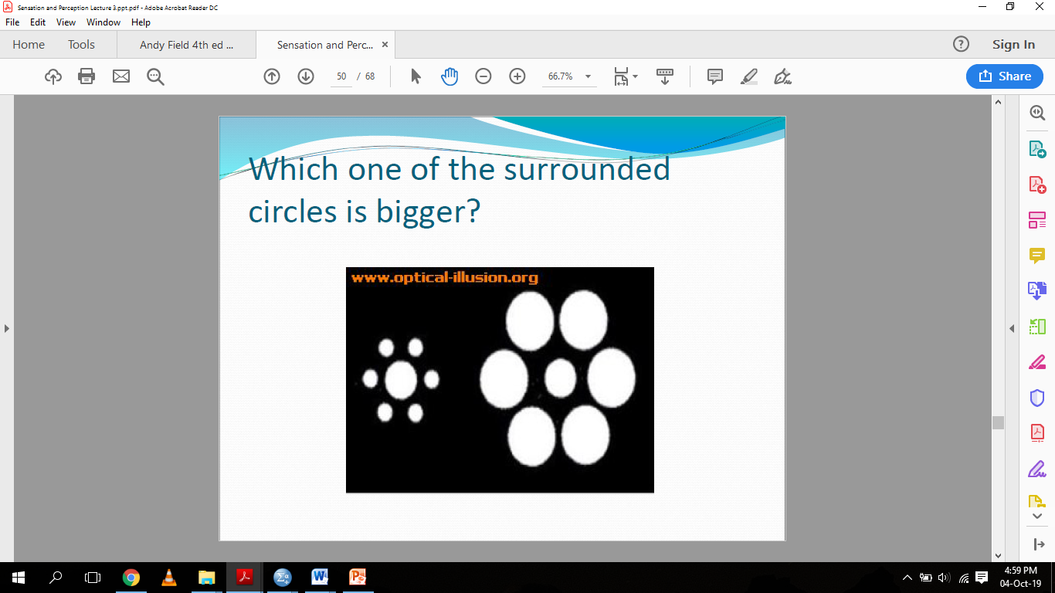

Slide 47
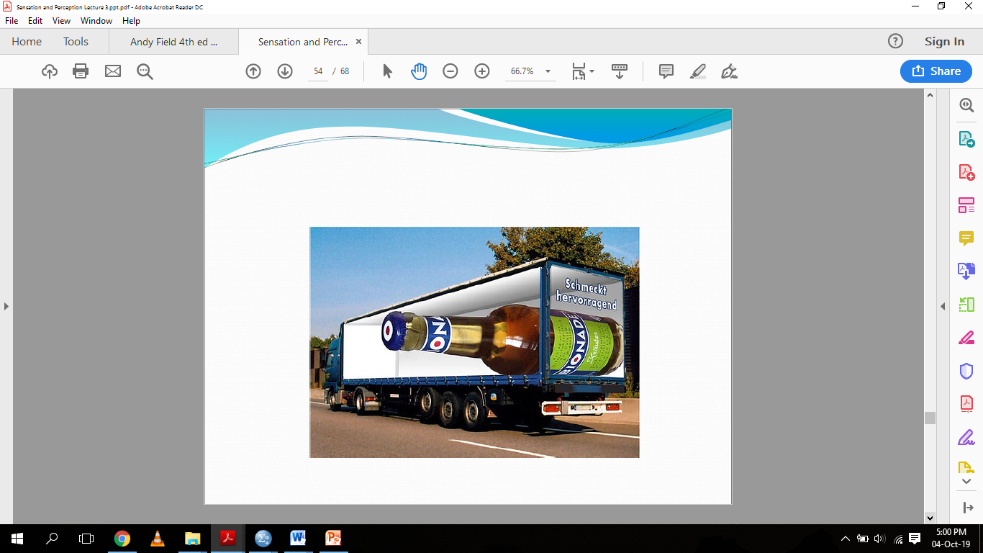

Slide 48
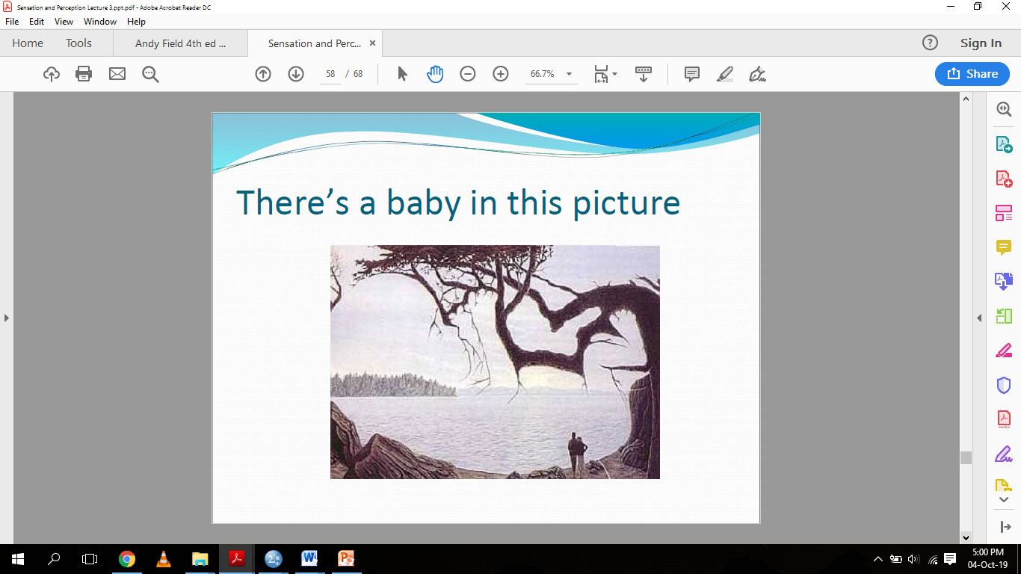

Slide 49
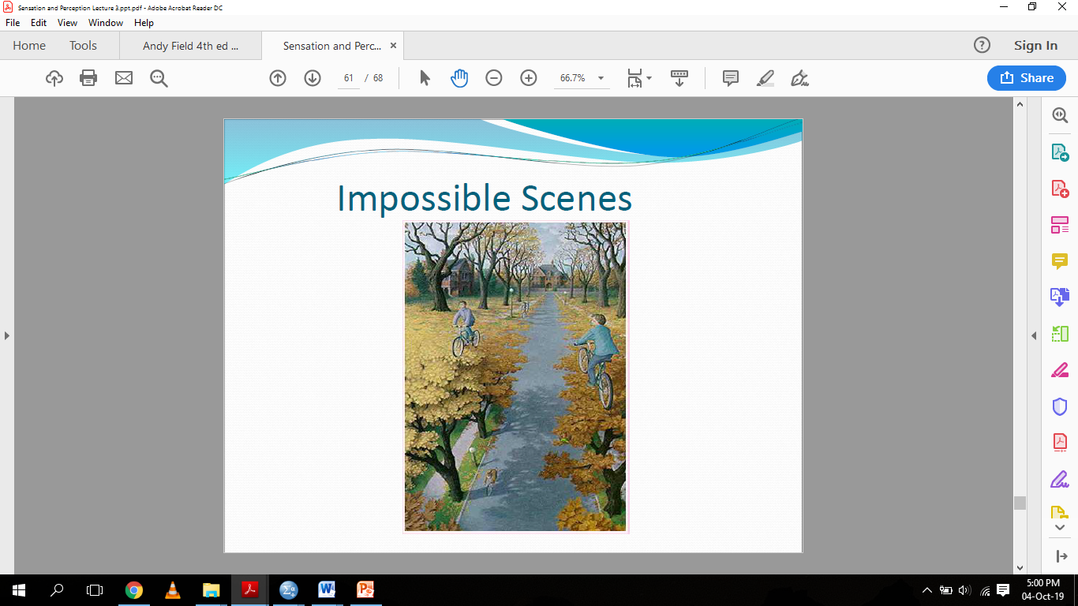

Slide 50
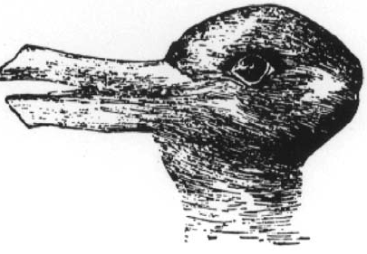
Prior Knowledge
The relationship between perception and prior knowledge of the world is manifested not only in simple geometric illusions but also in the interpretation of scientific data
Perceptions are influenced by past knowledge, previous hypotheses, and prejudices, as well as sensory signals
In figure can be seen as a duck or a rabbit
Which image you see is dependent upon your perspective and cues in the environment

Slide 51
THE EYE
An important and one of the most complex sense organ.
This sense organ are pretty much similar to cameras.
A human eye is roughly 2.3cm in diameter and is almost a spherical ball filled with some fluid.

Slide 52
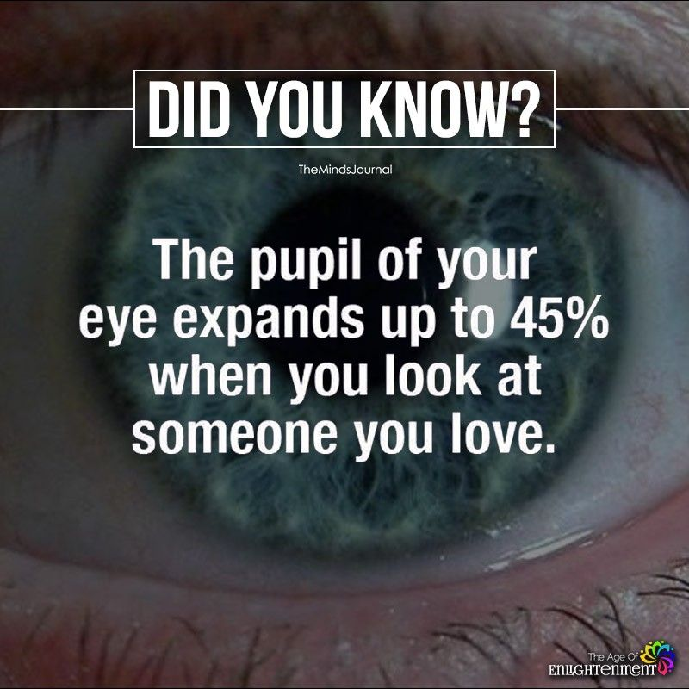

Slide 53
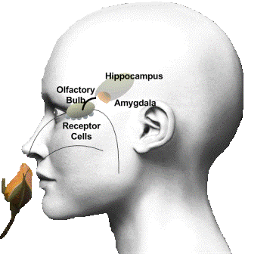
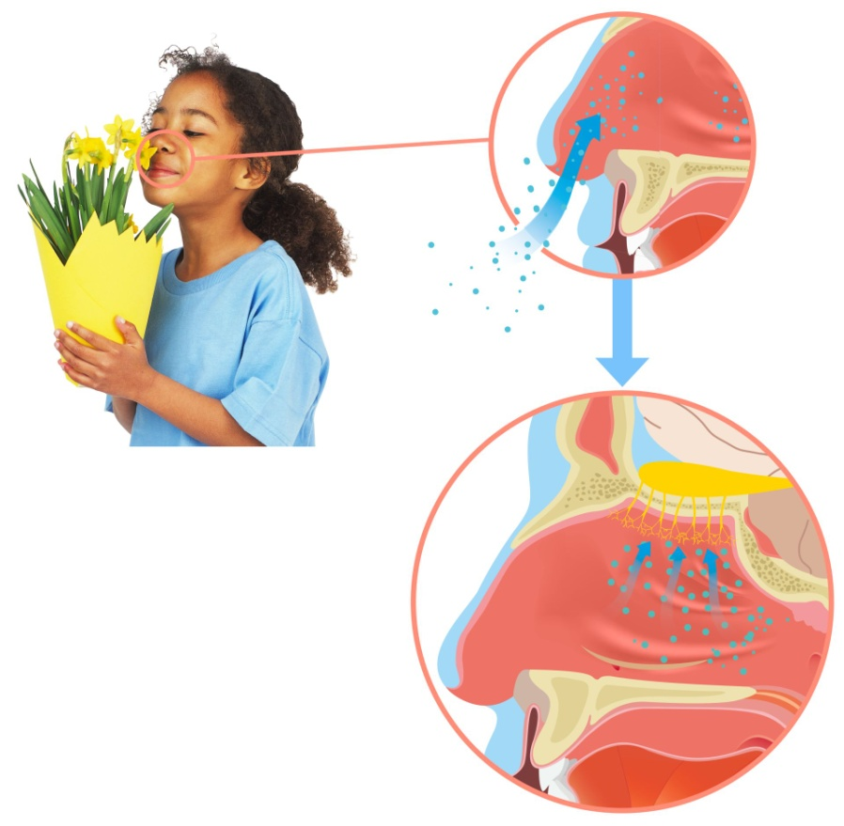
SMELL
Molecules are released by substances around us.
when they enter the nostrils, they can stimulate receptors located on the Olfactory sensory neurons in the back of the nose.
Those neurons send message to your brain, which identifies the smell.

Slide 54
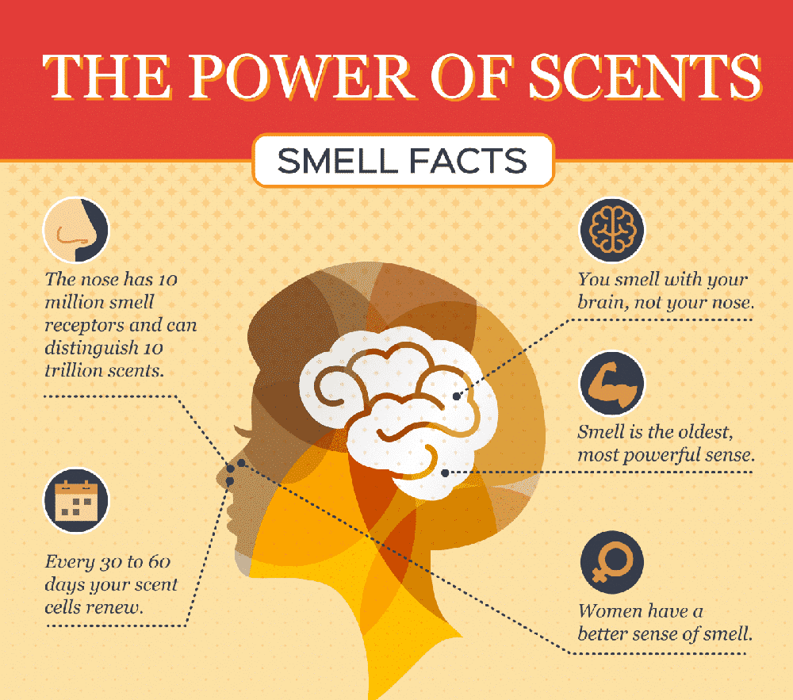

Slide 55
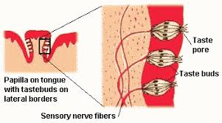
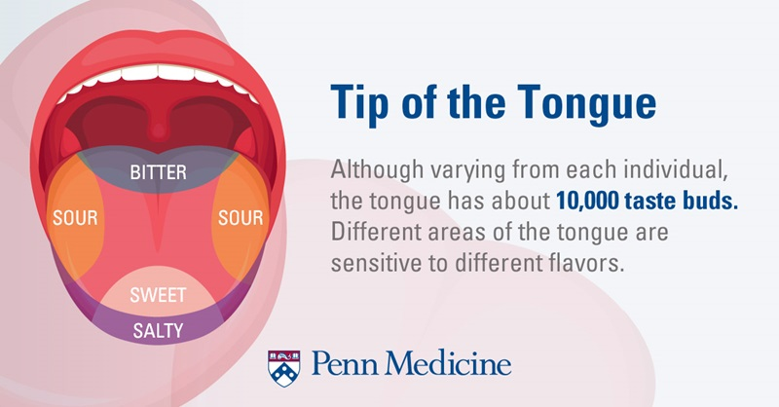
TASTE
The entire gustatory system is made up of the tongue, the papillae, taste buds and receptor cells.
our taste buds detect only five chemical stimuli.
On average, taste buds live for about five days, after which new taste buds are created to replace them.
This change helps explain why some foods that seems so bad in childhood are more enjoyable in adulthood.

